Slide 1


FLOW PUZZLE SOLVER

Slide 2

INSTRUCTION
Flow Puzzle Solver is an exciting puzzle game where players connect matching colors on a grid.
The twist? Our smart solver can finish the puzzle for you using AI!
Built with Python and Pygame, this game brings together fun, logic, and automation.

Slide 3

PROBLEM FORMULATION
INITIAL STATE:
A grid with unconnected pairs of colored dots and empty cells.
ACTIONS:
MOVE IN GRID to draw a path from one dot to its matching pair.
TRANSITION MODEL:
Drawing a path updates the grid by filling cells along the path.

Slide 4
PROBLEM FORMULATION
GOAL TEST:
All pairs of colored dots are correctly connected without
. overlapping paths, and the entire grid is filled.
PATH COST:
Each move has a cost of 1; the objective is to minimize the total
Number of moves or time taken.

Slide 5

PEAS

Slide 6
PEAS
Performance :
solve the Puzzle by connecting matched dots ,
without overlapping, with fewest moves and least time.
Enviroment :
N*N Grid ,Colored Dots.
Actuators :
Select and move on grid, draw and
delete paths.
sensors :
Detect current state , read positions,
validate rules.

Slide 7
ODESDA

Slide 8
ODESDA
Observable:
Fully observable
Deterministic:
Deterministic
Episodic:
Episodic
Static:
Static
Discrete:
Discrete
Agent:
Single Agent and cooperation

Slide 9
AGENT TYPE
Goal-based Agent:
because it makes decisions to achieve a
specific goal (solving the puzzle), using search
algorithms.

Slide 10
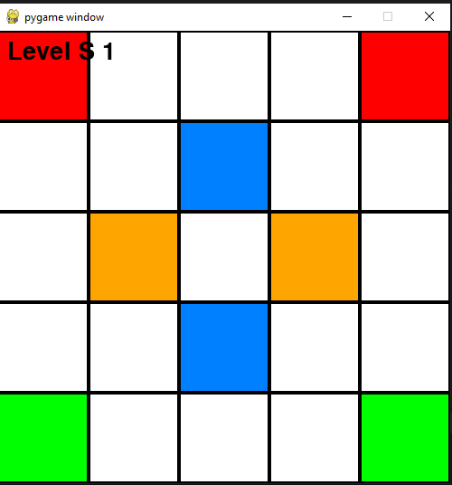
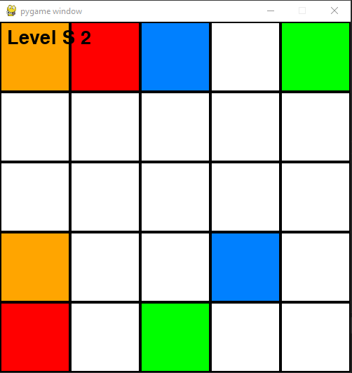
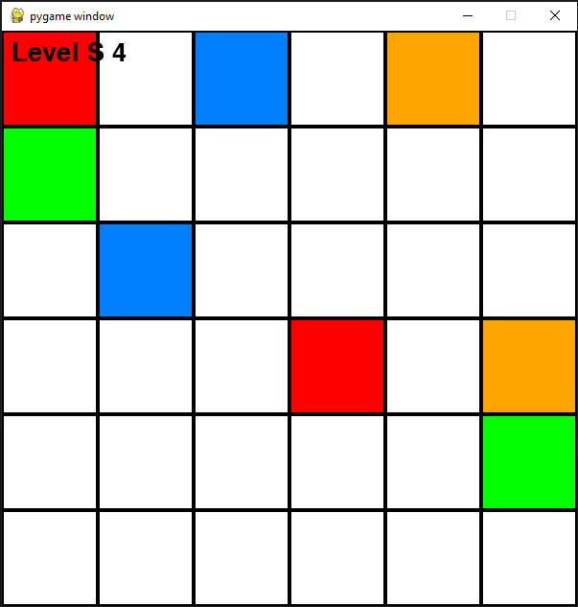


GAME UI

Slide 11
THANKS
UNTIL NEXT TIME

